Slide 1
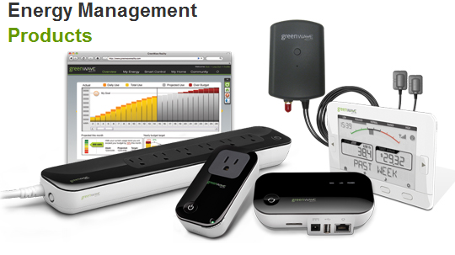
EMS Team Meeting
Johnny Nguyen
Camilo Aguilar
Christian Goldau
Charles Lam
April 16, 2013

Slide 2
Milestones-Last Quarter
Real time, wireless display.
Able to display 2 meters (but with interference problems).
Improving the code
More devices, more waveform features
Practiced Demo/Presentation Skills

Slide 3
Current Progress/Problems
Trouble with wireless
Demo/Demo code not working
Currently 11 waveform features in code
To be used in Chris’s code and microcontrollers

Slide 4
Future Tasks
Continue to debug demo code
Multiple meter wireless network
Assist/Train up new members

